Slide 1
I WILL GO AND SUSTAIN THE COMMUNITY FOR JESUS
Notes:
Out study ins based on the PNGUM Theme for this year, 2023:
“I will go and Sustain a Community for Jesus”

Slide 2
What is Sustainability?
…the capacity to maintain or improve the state and availability of desirable materials or conditions over the long term. (Wikipedia)
“meeting the needs of the present without compromising the ability of future generations to meet their own needs.” United nations, 1987
Notes:
Scholars say that a single specific definition of sustainability may never be possible. But the concept is still useful.
•"Sustainability can be defined as the capacity to maintain or improve the state and availability of desirable materials or conditions over the long term. (Wikipedia)

Slide 3
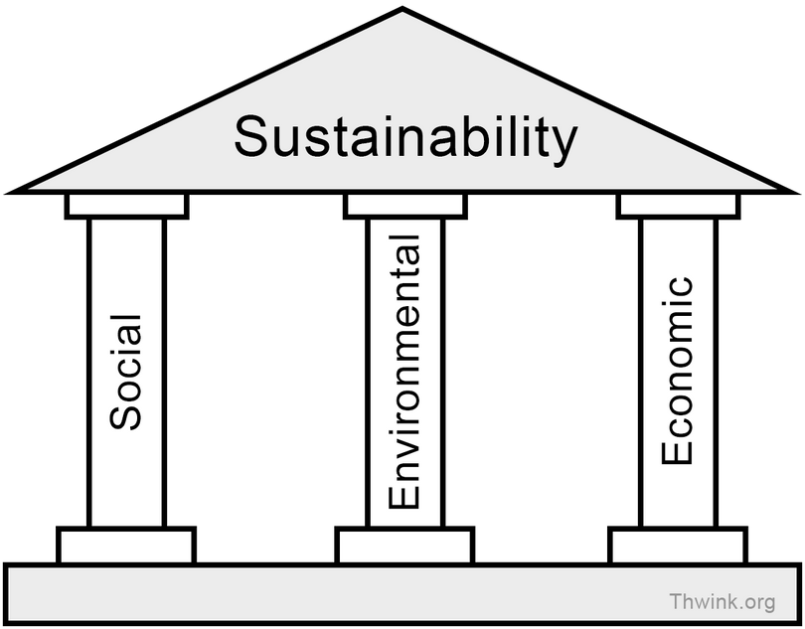
The 3 Principles Sustainability
Economy
Environment
Society

Slide 4
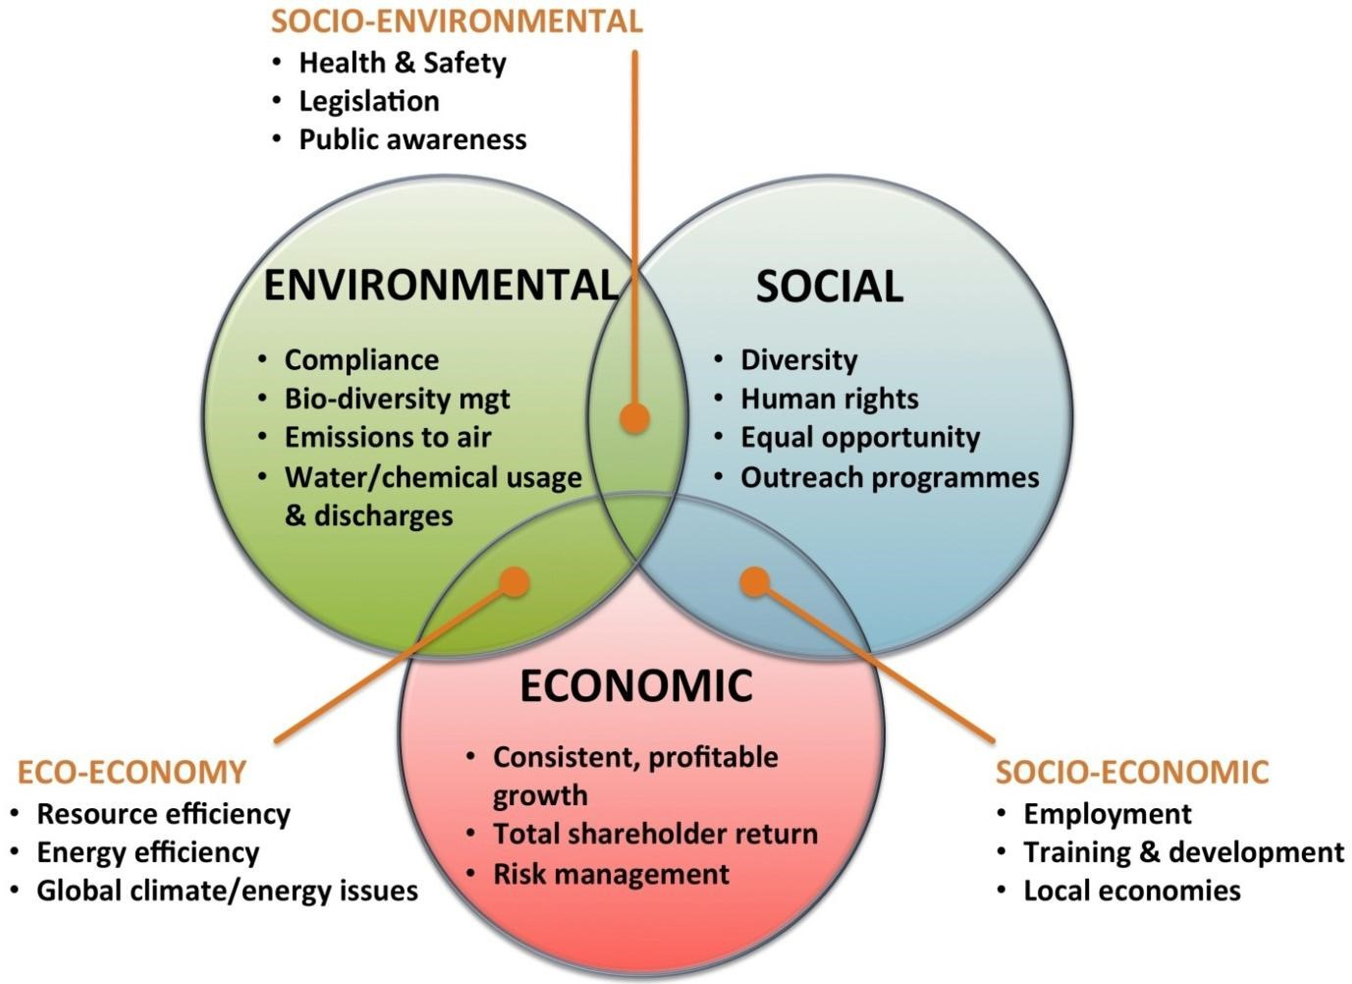
Notes:
-These principles seem to be intertwined, independent, and inseparable. As the world sees it, it is Wholistic Sustainability.
-But what is missing?
-All things listed here are God's Creation. But the Creator Himself is missing in the picture of sustainability .
We are simply looking to manage the things over which God claims total ownership and control.
-The world talks about suitability;
1. of the Created but not the Creator.
2. of the Temperal but not the Eternal.

Slide 5
Sustainability & Garden of Eden
Genesis 1 & 2
Notes:
The Theme for this week's study is: "SUSTAINABILITY & and the Garden of EDEN".
When God first created what were the PRINCIPLES or PILLARS put in place for the sustainability and livelihood of Human life and the Earth in General for eternity?
Only God can define what Holistic sustainability looks like.
And He laid the principles right from the beginning when he created the world and its inhabitants.
So what are the Principles?

Slide 6
Sustainability in the Garden of Eden
God
Environment –stewardship
Economy-Work
People –Society
Rest -Sabbath
Notes:
The Creation account clearly gives us the key Principles we need for the sustainability, of this life and eternity.
Here are the five Principles or Blessings:
1. God
2. Environment
3. Economy
4. People
5. Sabbath Rest
Today we begin with the First Blessing. 1. GOD -the Creator and Sustainer of the Universe.

Slide 7
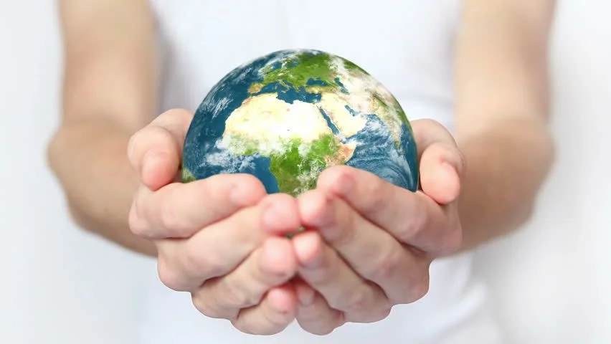
Principle 1:
GOD -Creator & Sustainer
Notes:
Today we begin with the First Blessing:
"God -the Creator and Sustainer - of the Universe if not only this world.
-God created the world.
but it was never meant to be independent of Him.
-Although the Physical human needs of the earth and its inhabitants were put in place to sustain itself,
but, the very lifeline of the animate and the existence of the inanimate depends on God.
-Before one begins to talk about the sustainability, of the earth and its inhabitants,
-One must be sure, to begin with, the Creator of life and everything we want to sustain.

Slide 8
God -Creator & Sustainer
CREATOR
Gen 1:1-2 " God Created"
Gen 2: 7 -God Breathed
the Holy Spirit
@ Creation - Gen 1:1-2
@ Incarnation - Luke 1:35
@ Recreation -rebirth - John 3:3-5
Notes:
CREATOR GOD:
1. In the beginning God Created all things.
2. He breathed life into all living things.
HOLY SPIRIT THE LIFE GIVER:
The Presence of the H/Spirit is life-giving.
In the Significant Evens of Human History, the Holy Spirit World at giving, and maintaining life.
1. Creation (Gen 1:2) -He covered the earth giving it life.
2. In Incarnation (Luk 1:35), Jesus was conceived, by the Spirit overshadowing Mary.
-and at Resurrection the Spirit brought Jesus back to life (Rom 8:11-13)
3. Salvation, the Creation is depends on the Baptism of the Holy Spirit (Jn 3:3, 5)
With out the presence of God and the Holy Spirit we are nothing.

Slide 9
SUSTAINER
" that you may love the Lord your God, that you may obey His voice, and that you may cling to Him, for He is your life and the length of your days; and that you may dwell in the land which the Lord swore to your fathers, to Abraham, Isaac, and Jacob, to give them.” Duet 30: 20, 21
Notes:
God is not Just the life giver but the “Life Himself the length of our days”

Slide 10
SUSTAINER
Acts 17:28 We live, move, and have our being in God
Ecc 12:13 Fearing God and Keeping His commandments –is man’s all.
Deut 30:21 –God is Israel's life and strength
Notes:
Act 17:28 -26 And He has made from one blood every nation of men to dwell on all the face of the earth, and has determined their preappointed times and the boundaries of their dwellings, 27 so that they should seek the Lord, in the hope that they might grope for Him and find Him, though He is not far from each one of us; 28 for in Him we live and move and have our being, as also some of your own poets have said, ‘For we are also His offspring.’
Ecc 12:13 13 Let us hear the conclusion of the whole matter: Fear God and keep His commandments, For this is man’s all. 14 For God will bring every work into judgment,
Including every secret thing, Whether good or evil.
Deut 30:21 20 that you may love the LORD your God, that you may obey His voice, and that you may cling to Him, for He is your life and the length of your days; and that you may dwell in the land which the LORD swore to your fathers, to Abraham, Isaac, and Jacob, to give them.”

Slide 11
Cast your burden on the Lord,
And He shall sustain you;
He shall never permit the righteous to be moved.
Ps 55:22
Notes:
He first Created and Gave Life, will He not also sustain this life, more so because we have fallen?
Isn't it the whole reason why he came? to Redeem us back, and restore us to eternity?

Slide 12
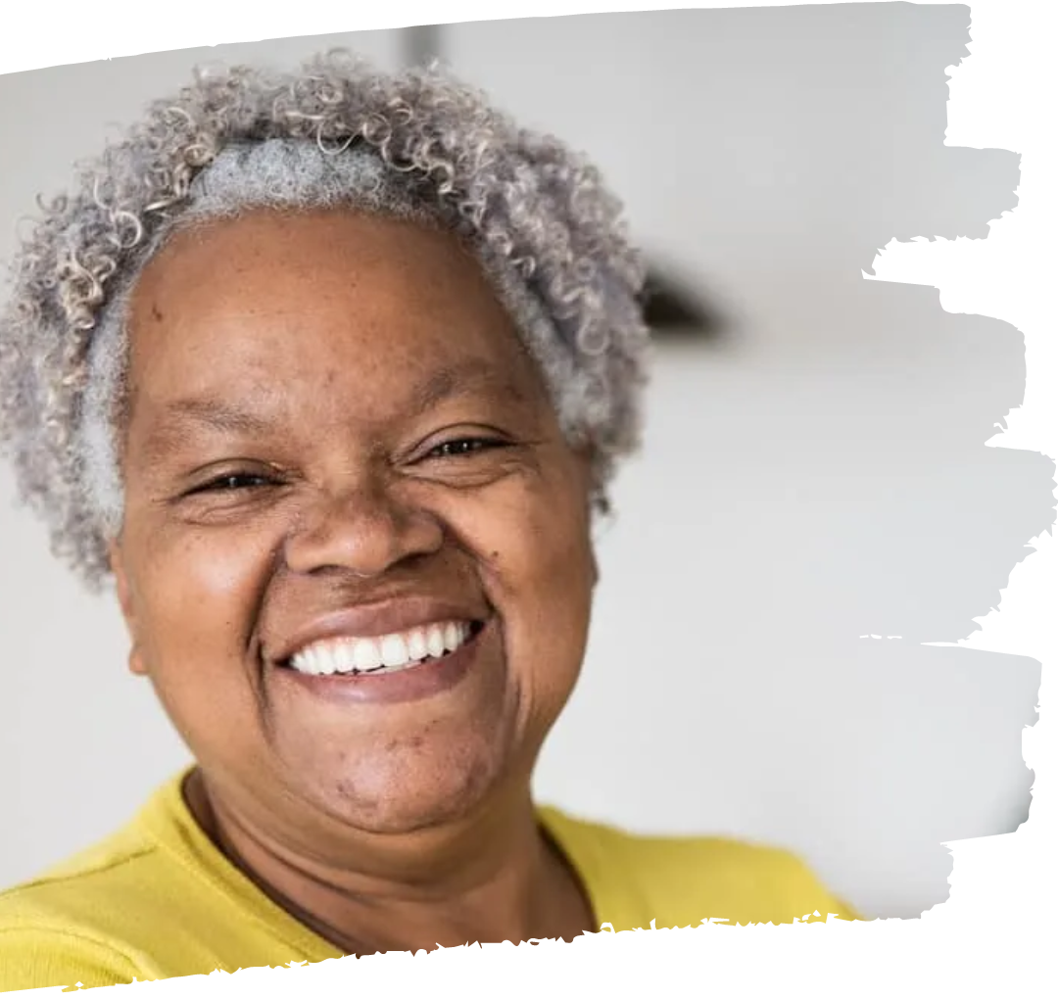
Isaiah 46:3-5
“Listen to me . .. all the remnant of the people of Israel, you whom I have upheld since your birth, and have carried since you were born. 4 Even to your old age and gray hairs I am he, I am he who will sustain you. I have made you and I will carry you; I will sustain you and I will rescue you.
5 “With whom will you compare me or count me equal? To whom will you liken me that we may be compared?
Notes:
This message may not sound out loud to the youth but, to the old and those growing old, it is a hope-giving and heart-warming message.
-It's a blessed thought to Know that God will sustain me, even when am old and gray, and that He will call me out from the dust of the earth unto eternity.

Slide 13
Challenge
Is the knowledge of the truth -God as the Creator and Sustainer - practical in my daily living?
Notes:
Life in its truest meaning is defined in light of God the creator, a life lived in acknowledgment and dependent on God as the creator and sustainer.
Is our knowledge of God as the creator and sustainer practical…
How am I demonstrating that in the biggest decisions of my life - and in the smallest.
Talking about Discipleship –unless one recognizes as a disciple and disciple-maker that God is the ultimate Sustainer and depends on Him, no results can be seen in the sustainability of discipleship, and holistically.

Slide 14
May God
bless His Word
JNembai
Notes:
It's my prayer that we live out this truth, by Trusting God and Depending on Him daily.
May God bless His Word.

